Slide 1
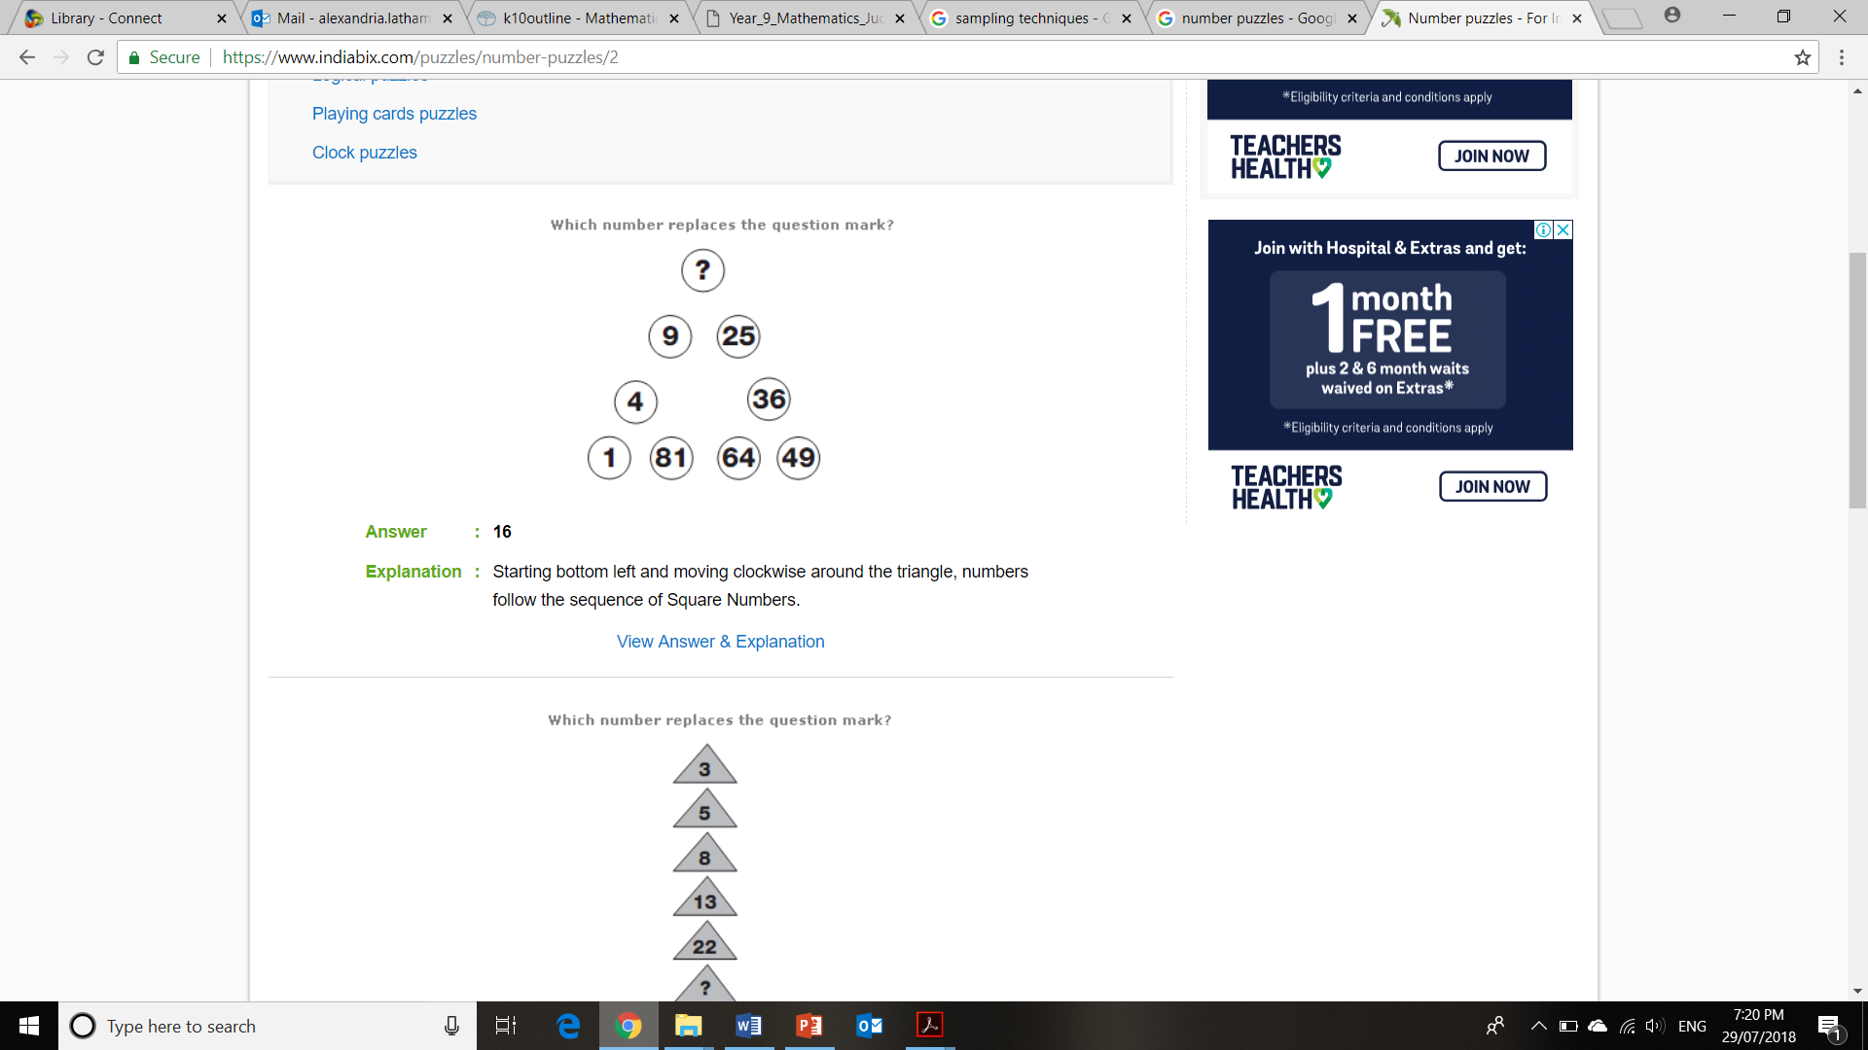
Topic: Data types and Collecting data
EQ: What are the different types of data?
Ms. Latham

Slide 2
24 7 30 WICOR
Summarise five points from the last lesson
Name a defining characteristic of a histogram
What does bimodal mean and when do we use this term?
In your INB find some frequency data and a frequency table. Show a friend.
Is there a difference between qualitative and quantitative data?

Slide 3
Add a Slide Title - 1

Slide 4
Topic: Data types and Collection
EQ: What are the different types of data
What are the different sources of data?
Data collection can either be primary (collected by you) or secondary (collected by someone else)
Examples: primary – survey, questionnaire, conducting trials
Secondary – Australian census, bureau of meteorology (weather data), AFL website (player and team statistics)
Data
Quantitative (numerical)
Qualitative (categorical)
Discrete (counting)
Continuous (measuring)
Nominal (no order just names)
Ordinal (has an order)
Data can be classified into two categories, with each category having a sub-category
What are the different types of data?

Slide 5
Topic: Data types and Collection
Data
Quantitative (numerical)
Qualitative (categorical)
Discrete (counting)
Continuous (measuring)
Nominal (no order just names)
Ordinal (has an order)
EQ: What are the different types of data
What are the different types of data?
Examples:
1. The number of goals scored by each team in the FIFA World Cup.
2. The height of each player at an AFL game.
3. The fitness level of everyone in the room (low, medium, high)
4. The city that each person in the room was born.
Discrete
Continuous
Ordinal
Nominal

Slide 6
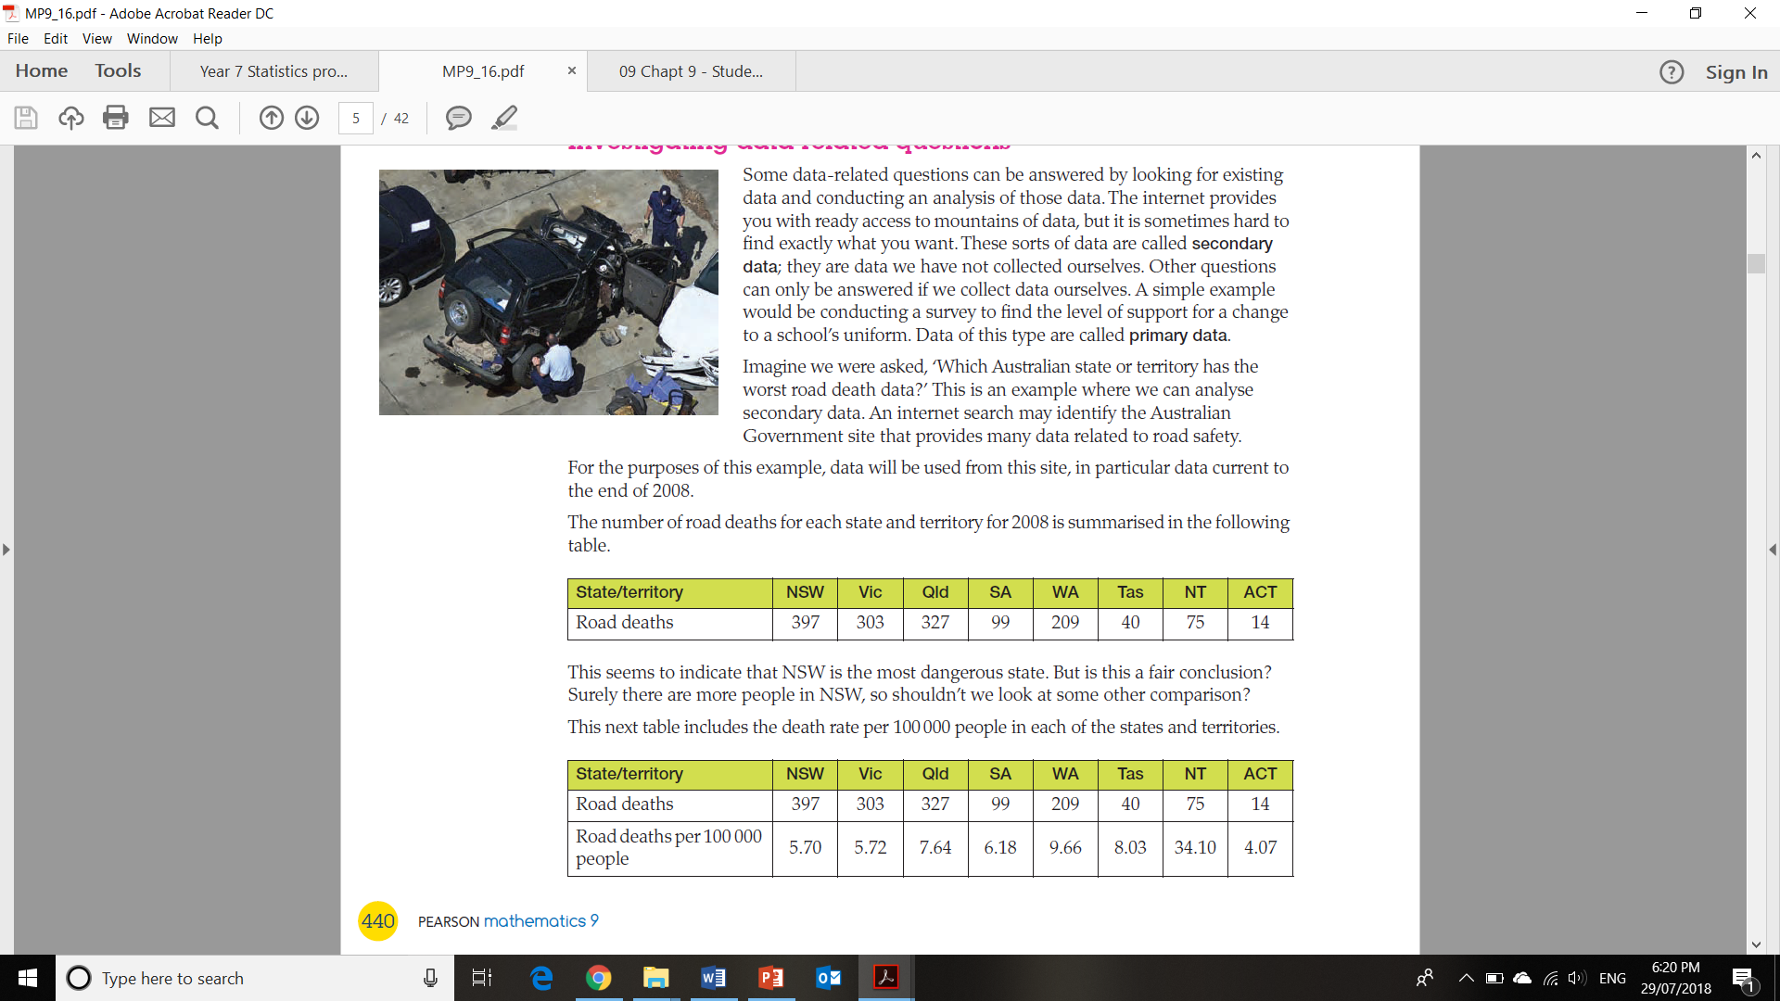
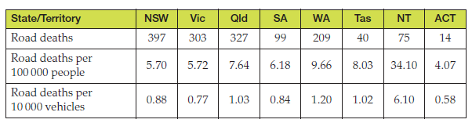

Example: Road Safety
Would we use primary or secondary data?
Secondary – it would be very hard to collect all the data ourselves, there could be many government websites that have data on road safety
If we were investigating the questions ‘Which Australian state or territory has the worst road death data?’
For this example we will use data from 2008:
Can we accurately say that NSW is the most dangerous state for driving? What else could be considered in making that judgement?
This next table includes the death rate per 100,000 people
Now our data is telling a different story…. The Northern Territory has a much higher rate than NSW and Victoria.
What else could we consider?
Not everyone drives cars… we could consider the number of registered vehicles.
Again we see the Northern Territory has a worse result and the ACT and Victoria coming out best.
So what could we conclude from the data?
The data seems to support the view that in 2007 the Northern Territory was the most dangerous place to be on the roads and the ACT was the safest.
It may be relevant to mention that in 2008 there was no speed limit on the open road in the Northern Territory, but there is one now.

Slide 7
Topic: Data types and Collection
EQ: What are the different types of data
How to conduct a survey?
Think – Pair - Share
What steps should the school take if it was interested in getting feedback from the school community about changing the school jumper?
Design the survey
Questions that can be tallied easily
Are the options easily understandable? Using pictures of jumper options
Interview or printed questionnaire
Who should be surveyed? Students/parents/teachers
Could you come up with other sampling techniques?
2. Running the survey
Census – interviewing everyone (wouldn’t be easy for a large school)
Representative sample of the population (example: interview 20 students from each year level, 50 parents and 50 teachers)
3. Analysing the survey – using statistical analysis

Slide 8

In your table groups:
Design an efficient survey on one of the following topics relating to our school:
Headphone usage in class
Changing the canteen food
Changing the school day schedule (26 hours a week still)

